Slide 1
READ ME This template uses the font ‘Space Grotesk’ – be sure to download the font before making edits to the deck. Here’s the link to the ZIP file containing the font. If you cannot access the link above, you can download the font for free via Google Fonts.

Slide 2
.NET Conf Student Zone

Slide 3
Tracks
01
Artificial Intelligence
Building Your Own Course Assistant with AI

Slide 4
Tracks
01
02
Artificial Intelligence
Web Development
Building Your Own Course Assistant with AI
Minimal API + SPA, a perfect match
Building an intelligent app with Blazor and Azure OpenAI

Slide 5
Tracks
01
02
03
Artificial Intelligence
Web Development
Mobile Development
Building Your Own Course Assistant with AI
Minimal API + SPA, a perfect match
Building an intelligent app with Blazor and Azure OpenAI
Get started building mobile & desktop apps with .NET

Slide 6
Tracks
01
02
03
04
Artificial Intelligence
Web Development
Mobile Development
Game Development
Building Your Own Course Assistant with AI
Minimal API + SPA, a perfect match
Building an intelligent app with Blazor and Azure OpenAI
Get started building mobile & desktop apps with .NET
Games in Godot! Let’s make a classic Paddle game with C#!
.NET Backend Mastery for Game Development
Coding a Drone Using .NET and ChatGPT AI & Flying in MR!

Slide 7
Check out the repo...
https://aka.ms/netconf23/studentrepo

Slide 8
What is .NET?
.NET
.NET is an open-source developer platform
Notes:
Our vision for .NET remains the same. Build a unified development platform for developers to build anything with best-in-class runtime, programming languages, development tools, and a vast ecosystem powered by amazing developers around the world.
With .NET, you can build any type of app that you need, for the devices critical to your business, and on the operating system of your choice. .NET will run fantastic anywhere and everywhere you deploy.
Build a website with Blazor and have it talk to a powerful .NET REST API. Take that same API and have it power mobile and desktop apps built with .NET. Infuse your apps with AI or leverage powerful cloud compute and services. .NET is there for you.

Slide 9
What is .NET?
.NET
.NET is an open-source developer platform
.NET is a toolkit for building apps
Notes:
Our vision for .NET remains the same. Build a unified development platform for developers to build anything with best-in-class runtime, programming languages, development tools, and a vast ecosystem powered by amazing developers around the world.
With .NET, you can build any type of app that you need, for the devices critical to your business, and on the operating system of your choice. .NET will run fantastic anywhere and everywhere you deploy.
Build a website with Blazor and have it talk to a powerful .NET REST API. Take that same API and have it power mobile and desktop apps built with .NET. Infuse your apps with AI or leverage powerful cloud compute and services. .NET is there for you.

Slide 10



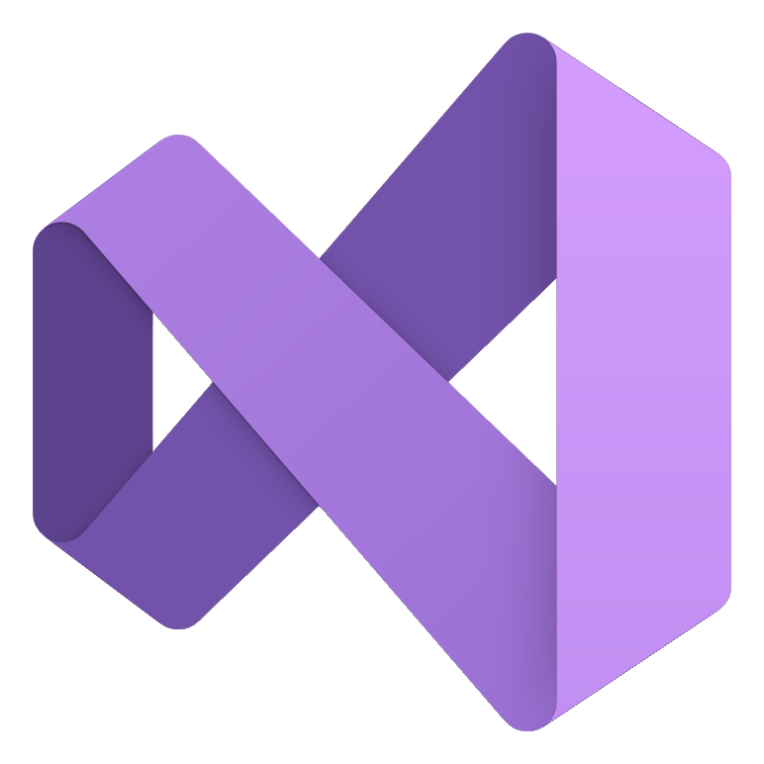








What is .NET?
.NET
.NET is an open-source developer platform
.NET is a toolkit for building apps
+
+
+
Visual studio
Family
Visual studio code
Cli
Linux
Nuget
Github
Components, tools, library vendors
C#
F#
VB
Windows
Macos
What languages can I use?
What tools can I use to build .NET apps?
Where can you RUN .NET?
What other support do I have?
Notes:
Our vision for .NET remains the same. Build a unified development platform for developers to build anything with best-in-class runtime, programming languages, development tools, and a vast ecosystem powered by amazing developers around the world.
With .NET, you can build any type of app that you need, for the devices critical to your business, and on the operating system of your choice. .NET will run fantastic anywhere and everywhere you deploy.
Build a website with Blazor and have it talk to a powerful .NET REST API. Take that same API and have it power mobile and desktop apps built with .NET. Infuse your apps with AI or leverage powerful cloud compute and services. .NET is there for you.

Slide 11
What is .NET?
.NET
Cloud
Web
Desktop
Mobile
Gaming
IoT
AI
What can I build?
+
+
+
Visual studio
Family
Visual studio code
Cli
Linux
Nuget
Github
Components, tools, library vendors
C#
F#
VB
Windows
Macos
What languages can I use?
What tools can I use to build .NET apps?
Where can you RUN .NET?
What other support do I have?
Notes:
Our vision for .NET remains the same. Build a unified development platform for developers to build anything with best-in-class runtime, programming languages, development tools, and a vast ecosystem powered by amazing developers around the world.
With .NET, you can build any type of app that you need, for the devices critical to your business, and on the operating system of your choice. .NET will run fantastic anywhere and everywhere you deploy.
Build a website with Blazor and have it talk to a powerful .NET REST API. Take that same API and have it power mobile and desktop apps built with .NET. Infuse your apps with AI or leverage powerful cloud compute and services. .NET is there for you.

Slide 12
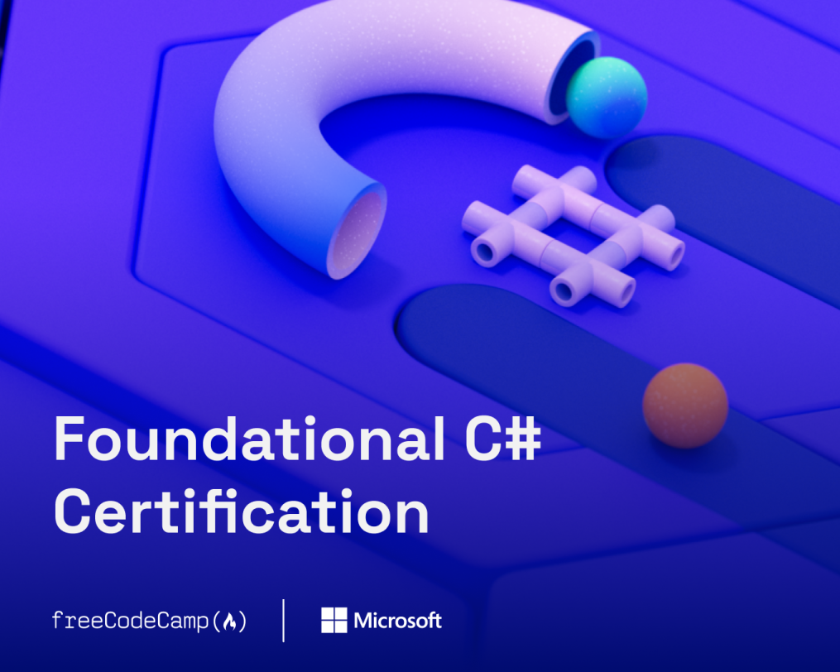
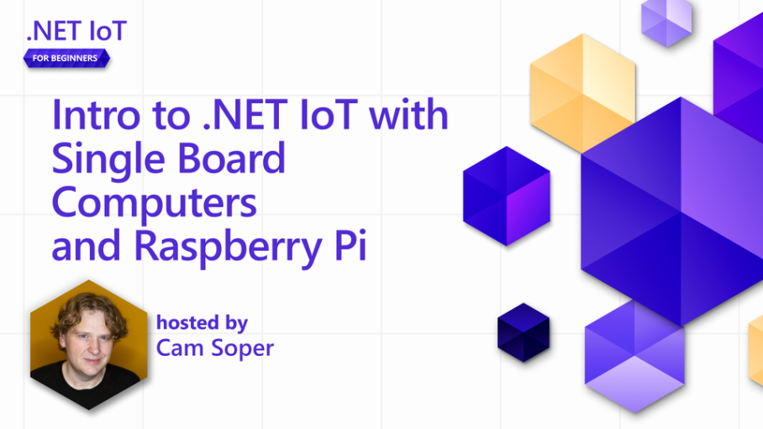
More ways to learn
Foundational C# Certification
https://aka.ms/csharp-certification
.NET Beginner Video Series
https://aka.ms/dotnetvideos

Slide 13
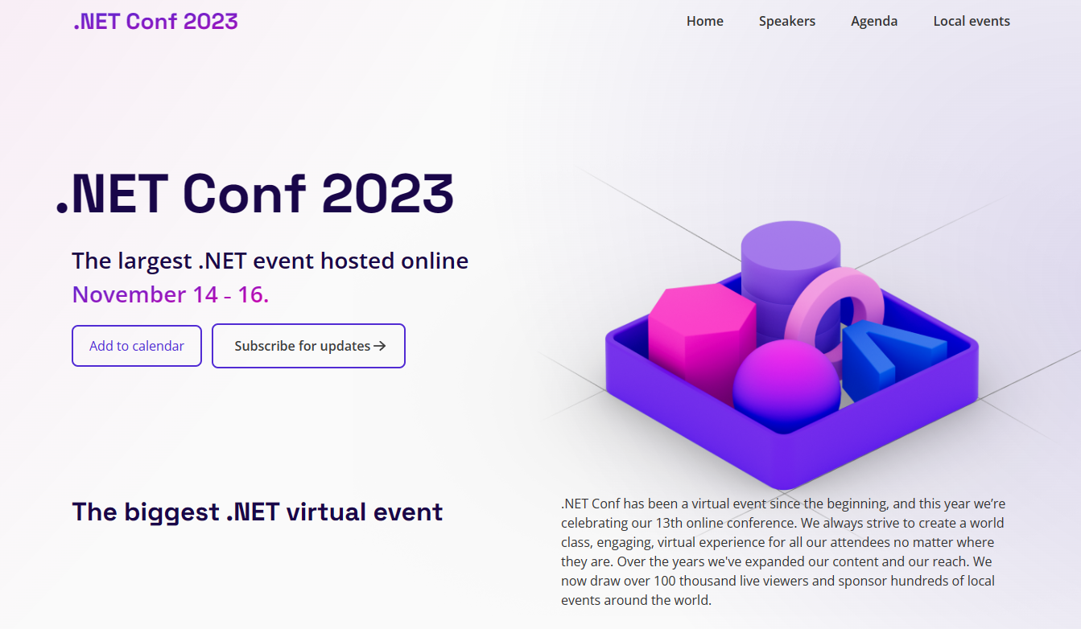
Tune into the rest of the conference...
https://aka.ms/dotnetconf23-studentzone

Slide 14
Session Review
01
02
03
04
Artificial Intelligence
Web Development
Mobile Development
Game Development
Building Your Own Course Assistant with AI
Minimal API + SPA, a perfect match
Building an intelligent app with Blazor and Azure OpenAI
Get started building mobile & desktop apps with .NET
Games in Godot! Let’s make a classic Paddle game with C#!
.NET Backend Mastery for Game Development
Coding a Drone Using .NET and ChatGPT AI & Flying in MR!

Slide 15
Student Zone Repository
https://aka.ms/netconf23/studentrepo
Foundational C# Certification
https://aka.ms/csharp-certification
.NET Beginner Videos
https://aka.ms/dotnetvideos
Watch .NET Conf, November 14-16
https://aka.ms/dotnetconf23-studentzone

